Slide 1

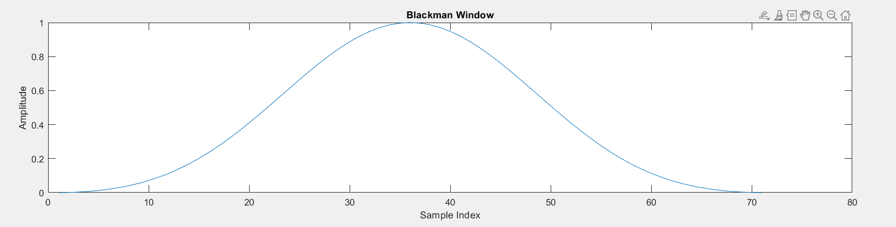
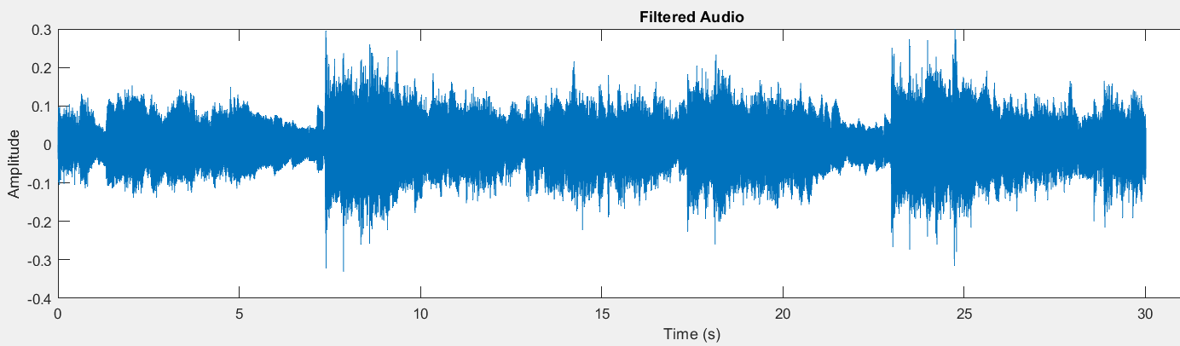
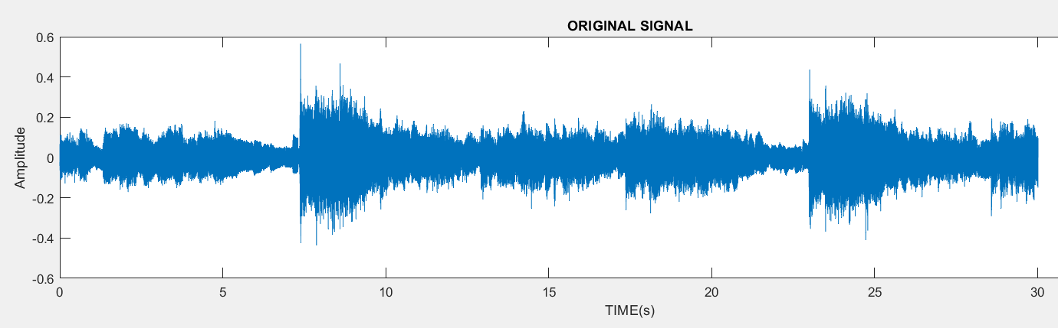
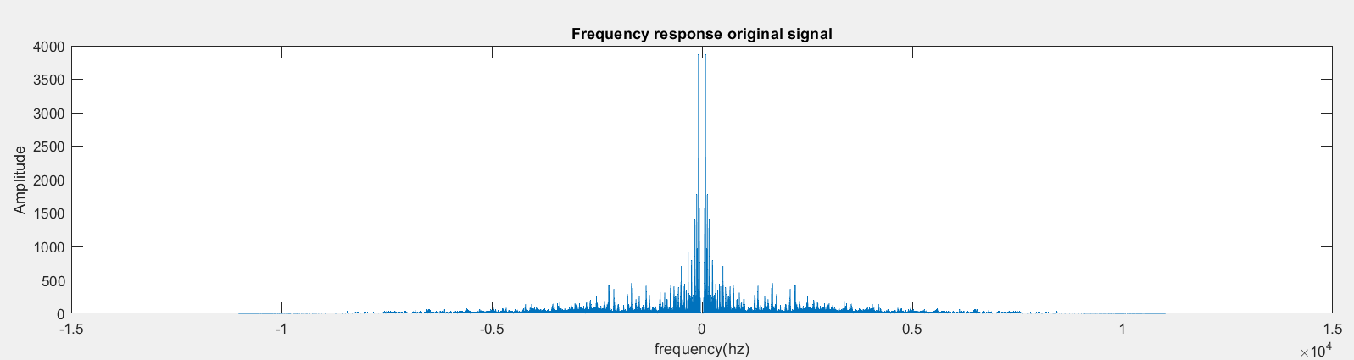
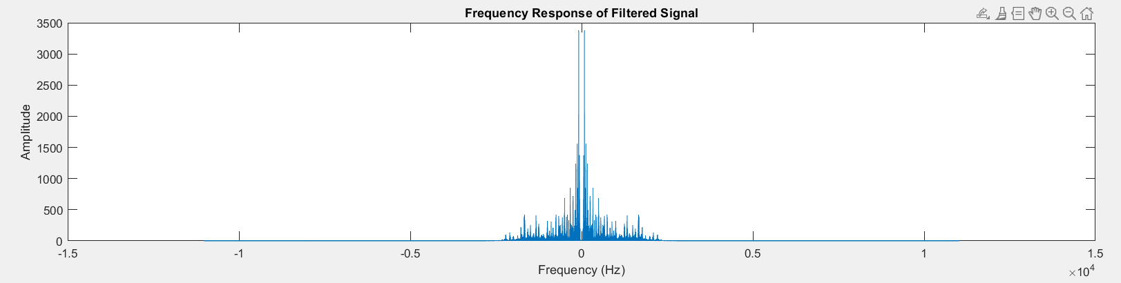
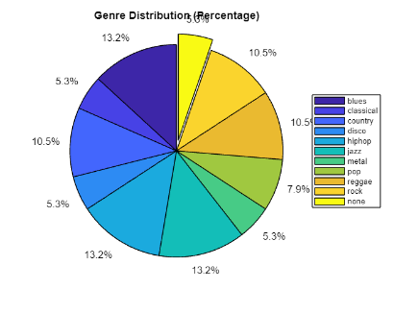
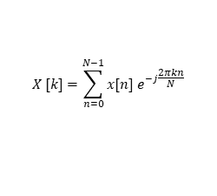



School of ECE
Music Genre Classification
Theme: Music synthesizer
Team T13: Shivananda Biradara, Rachanna Ullagaddi, Sonal Shet, Madhumati Mailarad.
DSP using PBL Approach 2023 - 2024
Need Statement
Signal Flow Diagram
Frequency Response of Filter
Music Genre are the categorical descriptions that are used to describe the music. Each category that identifies the music as belonging to a shared tradition or a set of conventions like Hip-Hop, rock, disco. Music Genre Classification has its purpose in categorizing the different music, this helps in creating favorite playlist by the users, suggestion of similar music, etc. This process is done using the musical features such as rhythm, melody, harmony, and timbre. The classification includes several steps like dataset acquisition, preprocessing of music, analyzing by applying Fourier transform, and suitable methods to classify genre.
Audio
signal
Filter
Frequency analysis
M1,M2
Classified genre
Model scouring
M5,M6
M3,M4
Fig: Frequency response of the FIR BP filter designed using Blackman window
Literature Survey
Signal Characteristics
Results
Music genre classification using transfer learning: Liang, B., & Gu, M. (2020, August). This review discusses on machine learning models KNN, CNN_MSD, CNN_MSD_big used for classifying the genres.
Automatic Music Classification and Summarization : D’Souza, D. A., & Shastrimath, V. V. D. (2019, March). This also uses ML models like Support Vector machine learning ,Automatic Summarization Algorithm for content based music retrieval.
Musical genre classification of audio signals​: G. Tzanetakis and P. Cook . This study give the information about Statistical pattern recognition to classify the music genres.
Signal Parameters
Time domain signal
Signal length | 30 sec
Amplitude range | -0.6 - 0.6
Sampling frequency | 22050 Hz
Frequency range | 50-2000 Hz
Time domain output
Fig: Blues audio Signal
Fig: Processed Blues signal
Frequency Spectrum
Frequency domain output
Challenges and Considerations
$$X [k]=\sum_{n=0}^{N−1}{x[n] e^{−j\frac{2πkn}{N}}}$$
Noise Reduction: To remove the unwanted signal by restriction the band of frequencies.
Computational Efficiency: To address computational complexity and memory requirements, the choice between Discrete Fourier Transform (DFT) and Fast Fourier Transform (FFT) methods.
Interpretability: To ensure that the extracted features and classification results are interpretable, and we can use these in the real world application.
Fig: Frequency Spectrum of Processed Blues signal
Fig: Frequency spectrum Blues audio signal
Frequency analysis to find the model parameters.
M1=35.4851 M2=64.2381 M3= 107.6660
M4=619.6582 M5=9.2195 e+03 M6=0.0731
Detected Genres are Blues, Metal, HipHop.
Original Genre Blues.
The spectrum shows frequency components of Blues audio signal. We require the frequencies in the range of 60-2000 hz and rest is noise.
Filter Design
Problem Definition
Concept Mapping: To extract the features of signal present the 60-2000hz frequency range.
Identified Filter : FIR Bandpass Filter using Blackman window
Design Parameters:
Inferences and Future Scope
Design signal processing method to enhance the quality of ECG signals and extract relevant features to enable accurate identification and classification of arrhythmias.
Apply DSP algorithms for Music Genre Classification.
Frequency domain analysis gave an insight of signal characteristics
This facilitated in selection and design of suitable digital filter.
The filtered output helped in identifying the models parameters required for classification of the music genre.
Usage of the machine learning algorithms like SVM, CNN, LSTM for better classification.
Passband edge frequencies (Hz) | Stopband edge frequencies (Hz) | Passband gain (dB) | Stopband gain (dB) | Filter order N
60, 2000 | 50, 2150 | -10 | -50 | 70
Objectives
Apply Fourier transform and Short term fourier transform to analyze the frequency components of Audio signals.
Designing a Band pass filter using digital filtering techniques to reduce noise.
Model scoring technique to compare the models and produce the output in the form of pie-chart.
Ideal impulse Response of Filter:
$$h_{d}\left[n\right]=\left\{\begin{matrix}\frac{\sin\left(ω_{c_{2}}(n−N)\right)−\sin\left(ω_{c_{1}}(n−N)\right)}{π(n−N)} & n≠N \\ \frac{ω_{c_{2}}−ω_{c_{1}}}{π} & n=N\end{matrix}\right.$$
Blackman window function:
$ω_{Blackman}\left[n\right]=0.42−0.5cos\left(\frac{2πn}{N−1}\right)$ $+0.08cos\left(\frac{4πn}{N−1}\right)$
Impulse Response of FIR BP Filter:
$$h[n]=h_{d}[n] ω[n]$$

